Slide 1
UNIT – 1 INTRODUCTION Part II
Programming in C (COM412)
BSc CSIT First Semester
Mid-West University
Birendranagar, Surkhet, Nepal
Prepared by:
Dabbal Singh Mahara
Asst. Prof.
2022

Slide 2
TOPICS COVERED
Introduction to C
History of C
Features and Applications
Limitations
Structure of C program
Compilation and Execution of C Program
Types of Errors
IDE

Slide 3
Introduction to C
C is a powerful general-purpose programming language.
It can be used to develop software like operating systems, databases, compilers, and so on.
C language is considered as the base language of most of the modern programming languages because most of the compilers, JVMs, Kernels, etc. are written in C language, and most of the programming languages follow C syntax, for example, C++, Java, C#, Perl etc.
It provides the core concepts like array, strings, functions, file handling, etc. that are being used in many languages.

Slide 4
Procedure-oriented programming language
C is a procedural language.
A procedure is known as a function, method, routine, subroutine, etc.
A procedural language specifies a series of steps for the program to solve the problem.
A procedural language breaks the program into functions, data structures, etc.

Slide 5
Structured programming language
C is a structured programming language.
Structured means to break a program into parts or blocks so that it may be easy to understand.
In the C language, we break the program into parts using functions.
It makes the program easier to understand and modify.

Slide 6
C as a System programming language
C language is a system programming language because it can be used to do low-level programming (for example driver and kernel).
It is generally used to create hardware devices, OS, drivers, kernels, etc. For example, Linux kernel is written in C.

Slide 7
Mid-level programming language
C language can be considered a middle-level language as it offers low-level control and high level convenience.
In C, we are able to manipulate bits, bytes, and addresses. It can interact with direct hardware and also able to carry out operation related to memory management.
C language behaves like as high-level language through functions, give modular programming, increased efficiency, and re-usability.

Slide 8
History of C language
C is a by-product of UNIX OS.
UNIX was written in assembly language by Ken Thompson for DEC PDP-7 at Bell Lab. But it was very painful to debug and hard to enhance.
So, Thompson himself developed a small language named B for further development of UNIX. B was based on BCPL, a system programming language during mid 1960s. BCPL was based on Algol 60 one of the influential language of 1960.
In 1970 Bell Lab acquired Dec PDP-11 for Unix project and UNIX rewritten in B to run on this new machine. In 1971 it was realized that B was not suitable language for PDP-11.

Slide 9
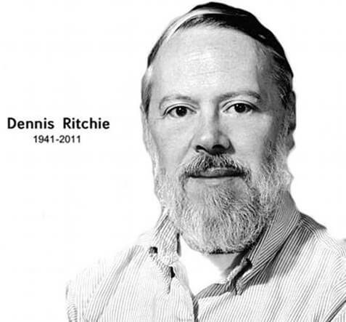
History of C language
So, Ritchie began to develop extended version of B. He called his new language as New B (NB) at first. But, it began diverge more from B, so he changed name to C.
C became stable by 1973 and UNIX was rewritten in C.
The switch to C provided an important benefit: Portability.
By writing C compilers for other computers at Bell Lab the team could get UNIX running on those machines as well.

Slide 10
History of C language
In 1978, Brian Kernighan and Dennis Ritchie produced the first publicly available description of C, as a book, “ The C Programming Language”, now known as the K&R standard.
In 1989, the C standard was ratified as "Programming Language C". This version of the language is often referred to as ANSI C, Standard C, or sometimes C89.
In 1990, the ANSI C standard (with formatting changes) was adopted by the International Organization for Standardization (ISO) which is sometimes called C90. Therefore, the terms "C89" and "C90" refer to the same programming language.

Slide 11
History of C language

Slide 12
Basic Features of C Language
Simple : C is a simple language in the sense that it provides a structured approach (to break the problem into parts), the rich set of library functions, data types, etc.
Machine Independent or Portable: Unlike assembly language, c programs can be executed on different machines with some machine specific changes. Therefore, C is a machine independent language.
Mid-level programming language: Although, C is intended to do low-level programming. It is used to develop system applications such as kernel, driver, etc. It also supports the features of a high-level language. That is why it is known as mid-level language.
Structured programming language: C is a structured programming language in the sense that we can break the program into parts using functions. So, it is easy to understand and modify. Functions also provide code reusability.
Rich Library: C provides a lot of inbuilt functions that make the development fast.

Slide 13
Basic Features of C Language
Memory Management: It supports the feature of dynamic memory allocation. In C language, we can free the allocated memory at any time by calling the free() function.
Speed: The compilation and execution time of C language is fast since there are lesser inbuilt functions and hence the lesser overhead.
Pointer: C provides the feature of pointers. We can directly interact with the memory by using the pointers. We can use pointers for memory, structures, functions, array, etc.
Recursion: In C, we can call the function within the function. It provides code reusability for every function. Recursion enables us to use the approach of backtracking.

Slide 14
Key Applications
'C' language is widely used in embedded systems.
Most of the applications by Adobe are developed using 'C' programming language.
It is used to develop databases. Oracle, MySQL are popular database software built using 'C'.
It is used in developing an operating system. Operating systems such as Apple's OS X, Microsoft's Windows, and Symbian are developed using 'C' language.
It is used for compiler production.
It is widely used in IOT applications.

Slide 15
The limitations of C
Difficult to debug.
C compilers can only identify syntax errors and are incapable of handling exceptions (run-time errors).
C provides no data protection.
It does not provide strict data type checking (for example an integer value can be passed for floating datatype).
C Programming Language doesn't support Object Oriented Programming(OOP) features like Inheritance, Encapsulation, Polymorphism etc.

Slide 16
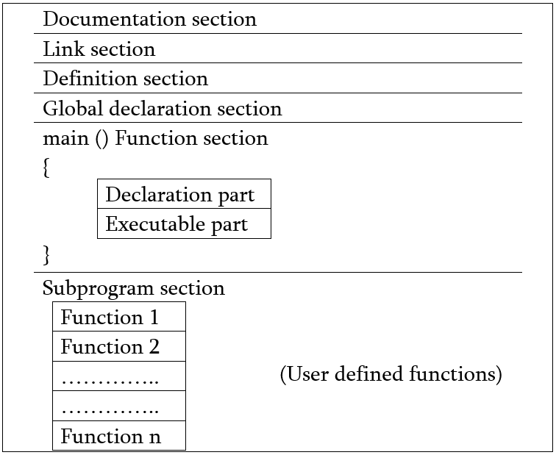
Structure of a C program

Slide 17
Structure of a C program
Documentation | Consists of comments, some description of the program, programmer name and any other useful points that can be referenced later.
Link | Provides instruction to the compiler to link function from the library function.
Definition | Consists of symbolic constants.

Slide 18
Structure of a C program
Global declaration | Consists of function declaration and global variables.
main( ) { } | Every C program must have a main() function which is the starting point of the program execution.
Subprograms | User defined functions.

Slide 19
MY First C Program
#include<stdio.h>
int main()
{
printf("Hello World !");
return 0;
}

Slide 20
Structure of a C program: Example
/*
* Program: circle.c
* author: Dabbal Mahara
* date: 2021-08-24
* description: program to find the area of a circle
* using the radius r
*/
#include <stdio.h>
#define PI 3.1416
float area(float r);
int main(void)
{
float r = 10;
printf("Area: %.2f", area(r));
return 0;
}
float area(float r) {
return PI * r * r;
}

Slide 21
Points to be noted…
Do not forget to use pre-processor at the beginning of the program.
The program must have the main function with a return type or not return type.
The program must have the block for defining the variables and writing code.
C is case sensitive programming language so you do have to care about the variables, keywords and cases.
Most of the time we use lower case for writing the codes in C, If you are using any other cases, you must have to remember.
Statement ends with semicolon otherwise that will return a syntax error.
Use indentation for better understanding the code and to make more readable and user-friendly.

Slide 22
The Steps for Compiling and executing C Program
Step1-
Use a text editor to write, edit or correct source code into C source code files having the “.c” file extension.
A text editor is usually used to enter the C program into a file.
Step2-
After the program has been written the next step is compilation process to translate the program using C compiler.
If the compiler doesn’t find any syntax errors in the program source code, it produces an object file. The compiler produces object files with an “.obj” file extension and the same name as the source code.
If compiler finds any errors in your program, it reports them and you need to return to Step 1 to make corrections in your source code.

Slide 23
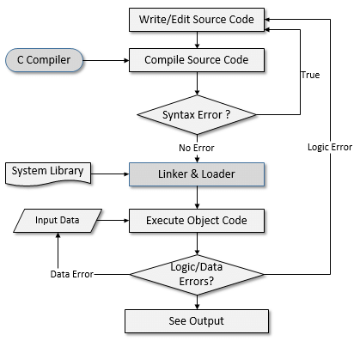
Process of compiling and running a C program

Slide 24
The Steps for Compiling and executing C Program
Step 3:
After the program has been translated into object code, it is ready to link the program using the linker.
If no errors occur, the linker produces an executable program located in a disk file with an “.exe” file extension with the same name as the object file.
Step 4:
Run the executable program and test whether it works properly as per the user requirements.
If the program does not produce the desired results, it is necessary to go back, start again with Step 1 and reanalyze the program’s logic and make modifications and additions to your source code.

Slide 25
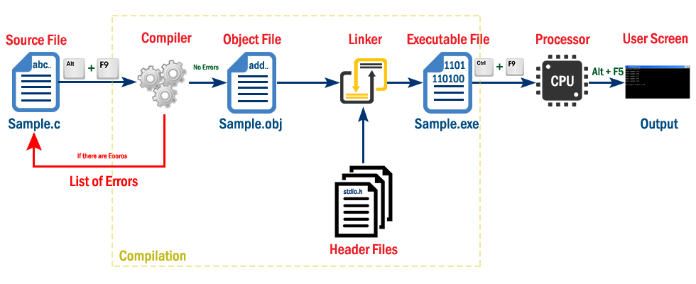
The Steps for Compiling and executing C Program

Slide 26
Integrated Development Environment (IDE)
The process of editing, compiling, running, and debugging programs is often managed by a single integrated application known as an Integrated Development Environment, or IDE for short.
An IDE is a windows-based program that allows us to easily manage large software programs, edit files in windows, and compile, link, run, and debug programs.

Slide 27
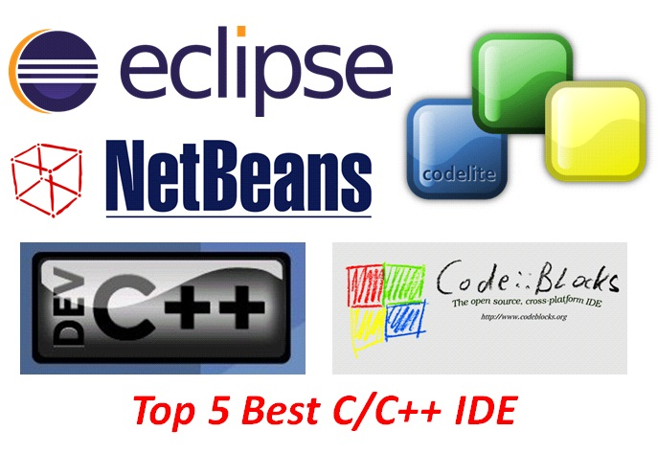
IDE : Examples

Slide 28
Debugging a C program
There are three basic categories of program errors:
1. Syntax Errors
2. Run-time Errors
3. Logic Errors
In the first two cases when an error occurs, the computer displays an 'Error Message', which describes the error, and its cause.
In the final case, the program will not show an error message but it will not do what the programmer wanted it to do.

Slide 29
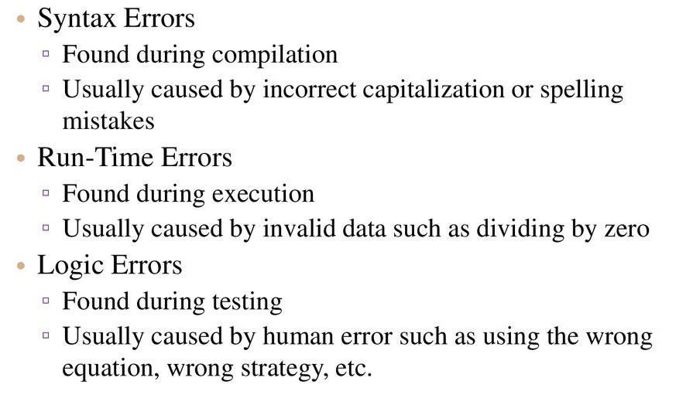
Program Errors

Slide 30
Assignment #3
Discuss the history of C.
What are the features of C?
What are the problems with the C?
Describe the applications of C.
Explain compilation and execution of C program with flowchart.
What are the different types of programming errors?
Explain the structure of C program with an example.

Slide 31


